Slide 1
Ethical Hacking Intership Task 3
C N ADITYA SAI

Slide 2
REPORT 1
Report Title:
Data is being transmitted on http protocol on http://testasp.vulnweb.com/Default.asp?
Summary:
All the sensitive data is being transmitted over HTTP, HTTP transmits the data on plain text over the internet. So if an attacker intercepts the traffic he can read all the text include user credentials like usernames, password and other sensitive information.
Severity of the issue: High
Impact:
If an attacker can intercept network traffic, he/she can steal user’s credentials.

Slide 3
REPORT 2
Report Title:
Cross-site Scripting, which allows an attacker to execute a dynamic script.
Summary:
Cross-site Scripting attacks are a type of injection vulnerability, in which maliciopus scripts are injected into otherwise trusted websites. This allows several different attack oppurtunities, mostly hijacking the current session of the user or changing the look of the page by changing the HTML on the fly to steal the user’s credentials. It targets the application instead of the server. Although this is a limitation, since it allows attackers to hijack other user’s sessions, an attacker might attack an admin to gain full control over the application.
Severity of the issue: High

Slide 4
REPORT 2
Steps to reproduce:
Find any input field such as search box, etc.
Enter the script into the input field and if any user loads that page the script executes.
Impact:
There are many different attacks that can be leveraged through the use of cross-site scripting, including:
Hijacking user’s active session
Mounting Phishing attacks
Intercepting data and performing man-in-the-middle attacks.

Slide 5
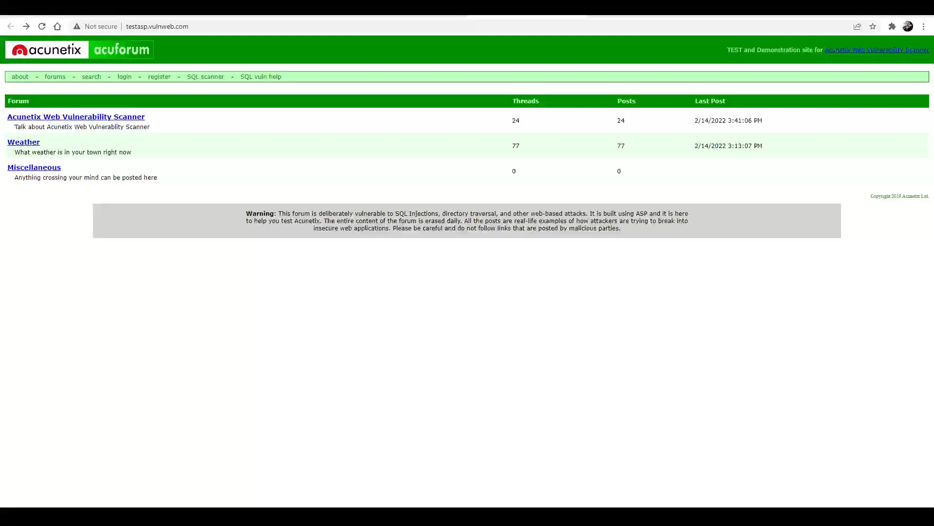
REPORT 2
POC Video

Slide 6
REPORT 3
Report Title:
Default admin username and password used
Summary:
The username and password of the administrator is set to as admin, which might cause admin access to any person who tries the combination. He can access and steal other user’s credentials using this account.
Severity of the issue: High
Steps to reproduce:
Go into the login page
Enter the username and password as ‘admin’

Slide 7
REPORT 2
Impact:
Any person who gets access to the account can perform the following:
Access other user’s account
Access other user’s credentials
Steal and access on basis of their account.

Slide 8

REPORT 2
POC Video

Slide 9
Thank You

